Slide 1
Blacktown Chinese Christian Church
Welcome to Our English Service 06.04.2025
English Service 9:45 – 11:00 am
Worship Songs: Passage: Speaker: Topic: Response Song: Announcements and Closing Prayer Benediction
Come Thou Fount My Labour Is Not In Vain Lighthouse Joshua 3 No Text Found TBA TBA TBA

Slide 2
BCCC english service

Slide 3

Please keep all phones on silent

Slide 4
Come Thou Fount
CCLI Licence No: 5485849

Slide 5
Verse 1
Come, thou Fount of every blessing;
tune my heart to sing thy grace;
streams of mercy, never ceasing,
call for songs of loudest praise.

Slide 6
Verse 1
Teach me some melodious sonnet,
sung by flaming tongues above;
praise the mount! I’m fixed upon it,
mount of God’s unchanging love!

Slide 7
Verse 2
Here I raise my Ebenezer;
hither by thy help I’m come;
and I hope, by thy good pleasure,
safely to arrive at home.

Slide 8
Verse 2
Jesus sought me when a stranger,
wandering from the fold of God;
he, to rescue me from danger,
interposed his precious blood.

Slide 9
Verse 3
O to grace how great a debtor
daily I’m constrained to be!
Let that grace now, like a fetter,
bind my wandering heart to thee.

Slide 10
Verse 3
Prone to wander, Lord, I feel it,
prone to leave the God I love;
here’s my heart; O take and seal it;
seal it for thy courts above.

Slide 11
My Labour Is Not In Vain
CCLI Licence No: 5485849

Slide 12
Verse 1
My work in Christ is not in vain
My labor will not fail
For when I toil in Jesus’ name
His purpose will prevail

Slide 13
Verse 2
The tasks that You have set for me
I may not understand
Yet I will follow where You lead
I trust Your sovereign hand

Slide 14
Chorus
So may all I do, be it great or small
Bring glory to Your name

Slide 15
Chorus
In Your grace alone I will car – ry on
Your promise to me remains
My labour is not in vain

Slide 16
Verse 3
Go forth, You said, take up your cross
And set the captive free
So give me feet to seek the lost
Just as You searched for me

Slide 17
Chorus
So may all I do, be it great or small
Bring glory to Your name

Slide 18
Chorus
In Your grace alone I will car – ry on
Your promise to me remains
My labour is not in vain

Slide 19
Verse 4
Take heart, my soul, and persevere
Just as your Saviour did
For soon you will be home at rest
Your work, complete in Him

Slide 20
Chrous
So may all I do, be it great or small
Bring glory to Your name

Slide 21
Chrous
In Your grace alone I will car – ry on
Your promise to me remains
My labour is not in vain

Slide 22
Chrous
So may all I do, be it great or small
Bring glory to Your name

Slide 23
Chrous
In Your grace alone I will car – ry on
Your promise to me remains
My labour is not in vain

Slide 24
My Lighthouse
Chris Llewellyn, Gareth Gilkeson © 2013 Thankyou Music (Admin. by SHOUT! Music Publishing Australia) CCLI Licence No. 5485849 . CCLI Song number: 7002032

Slide 25
Verse 1
In my wrestling and in my doubts
In my failures You won't walk out

Slide 26
Verse 1
Your great love will lead me through
You are the peace in my troubled sea
You are the peace in my troubled sea

Slide 27
Verse 2
In the silence, You won't let go
In my questions, Your truth will hold

Slide 28
Verse 2
Your great love will lead me through
You are the peace in my troubled sea
You are the peace in my troubled sea

Slide 29
Chorus
My lighthouse
My lighthouse
Shining in the darkness
I will follow You

Slide 30
Chorus
My lighthouse
My lighthouse
I will trust the promise
You will carry me safe to shore

Slide 31
Chorus
Safe to shore
Safe to shore
Safe to shore

Slide 32
Verse 3
I won't fear what tomorrow brings
With each morning I'll rise and sing

Slide 33
Verse 3
My God's love will lead me through
You are the peace in my troubled sea
You are the peace in my troubled sea

Slide 34
Chorus
My lighthouse
My lighthouse
Shining in the darkness
I will follow You

Slide 35
Chorus
My lighthouse
My lighthouse
I will trust the promise
You will carry me safe to shore

Slide 36
Chorus
Safe to shore
Safe to shore
Safe to shore

Slide 37
Bridge
Fire before us, You're the brightest
You will lead us through the storms (x4)

Slide 38
Chorus
My lighthouse
My lighthouse
Shining in the darkness
I will follow You

Slide 39
Chorus
My lighthouse
My lighthouse
I will trust the promise
You will carry me safe to shore

Slide 40
Chorus
Safe to shore
Safe to shore
Safe to shore

Slide 41
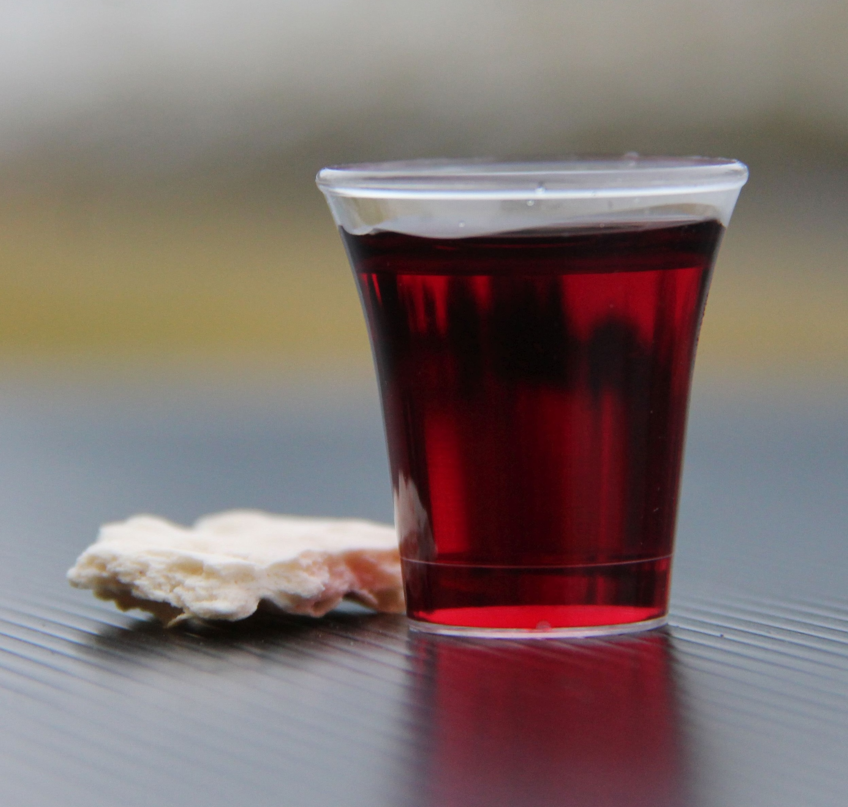
Holy Communion

Slide 42

Bible reading

Slide 43
Joshua 3 (NIV)
Early in the morning Joshua and all the Israelites set out from Shittim and went to the Jordan, where they camped before crossing over. ² After three days the officers went throughout the camp,

Slide 44
Joshua 3 (NIV)
³ giving orders to the people: “When you see the ark of the covenant of the Lord your God, and the Levitical priests carrying it, you are to move out from your positions and follow it. ⁴ Then you will know which way to go, since you have never been this way before. But keep a distance of about two thousand cubits between you and the ark; do not go near it.”

Slide 45
Joshua 3 (NIV)
⁵ Joshua told the people, “Consecrate yourselves, for tomorrow the Lord will do amazing things among you.”
⁶ Joshua said to the priests, “Take up the ark of the covenant and pass on ahead of the people.” So they took it up and went ahead of them.

Slide 46
Joshua 3 (NIV)
⁷ And the Lord said to Joshua, “Today I will begin to exalt you in the eyes of all Israel, so they may know that I am with you as I was with Moses. ⁸ Tell the priests who carry the ark of the covenant: ‘When you reach the edge of the Jordan’s waters, go and stand in the river.’”

Slide 47
Joshua 3 (NIV)
⁹ Joshua said to the Israelites, “Come here and listen to the words of the Lord your God. ¹⁰ This is how you will know that the living God is among you and that he will certainly drive out before you the Canaanites, Hittites, Hivites, Perizzites, Girgashites, Amorites and Jebusites.

Slide 48
Joshua 3 (NIV)
¹¹ See, the ark of the covenant of the Lord of all the earth will go into the Jordan ahead of you. ¹² Now then, choose twelve men from the tribes of Israel, one from each tribe.

Slide 49
Joshua 3 (NIV)
¹³ And as soon as the priests who carry the ark of the Lord—the Lord of all the earth—set foot in the Jordan, its waters flowing downstream will be cut off and stand up in a heap.”
¹⁴ So when the people broke camp to cross the Jordan, the priests carrying the ark of the covenant went ahead of them.

Slide 50
Joshua 3 (NIV)
¹⁵ Now the Jordan is at flood stage all during harvest. Yet as soon as the priests who carried the ark reached the Jordan and their feet touched the water’s edge, ¹⁶ the water from upstream stopped flowing. It piled up in a heap a great distance away, at a town called Adam in the vicinity of Zarethan, while the water flowing down to the Sea of the Arabah (that is, the Dead Sea) was completely cut off. So the people crossed over opposite Jericho.

Slide 51
Joshua 3 (NIV)
¹⁷ The priests who carried the ark of the covenant of the Lord stopped in the middle of the Jordan and stood on dry ground, while all Israel passed by until the whole nation had completed the crossing on dry ground.

Slide 52
Scripture quotations taken from The Holy Bible, New International Version® NIV®
Copyright © 1973, 1978, 1984, 2011 by Biblica, Inc.
Used with permission. All rights reserved worldwide.

Slide 53
Announcements

Slide 54





Account name: Blacktown Chinese Christian Church
Account number: 4216 50263
Offering
BSB: 112 - 879
Please put in "offering" as the reference
The offering box is available at the back of the hall

Slide 55
Prayer points

Slide 56
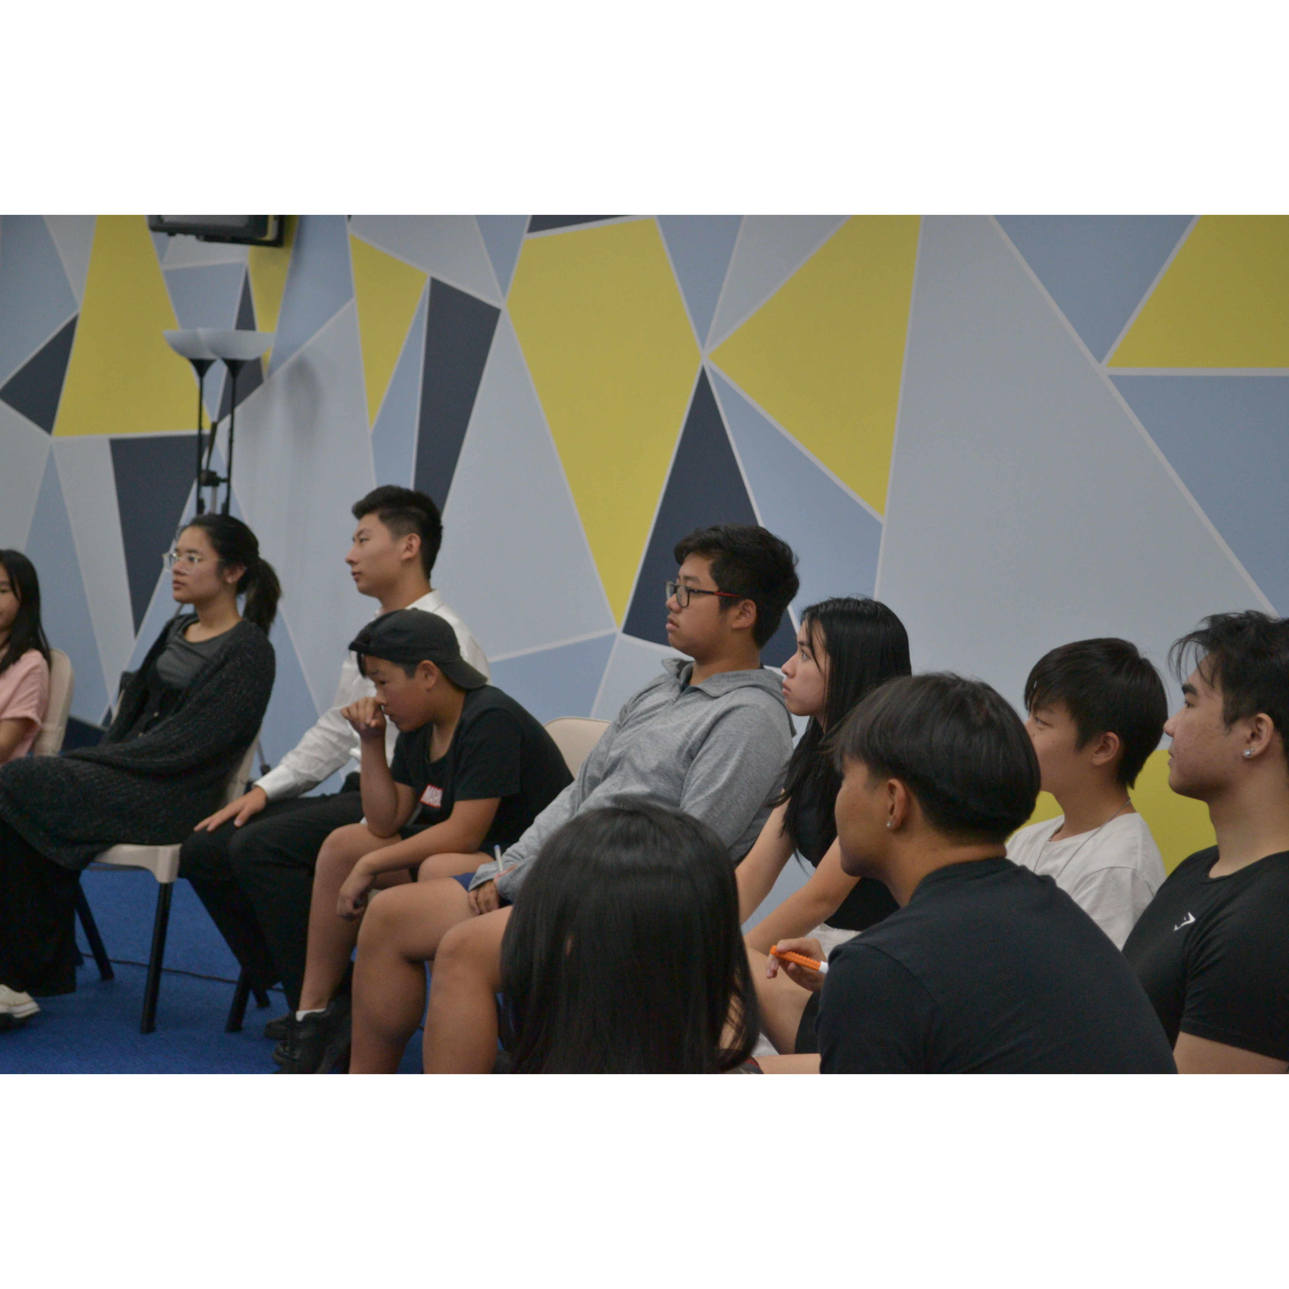
Mingle time!

